Slide 1
Learning Objective
I will be able to key features of a rectangular hyperbola and apply function transformations
Success Criteria
At the end of the lesson, I will be able to:
Sketch rectangular parabolas;
Determine key features of a rectangular parabola;
Apply transformations on a rectangular parabola.

Slide 2









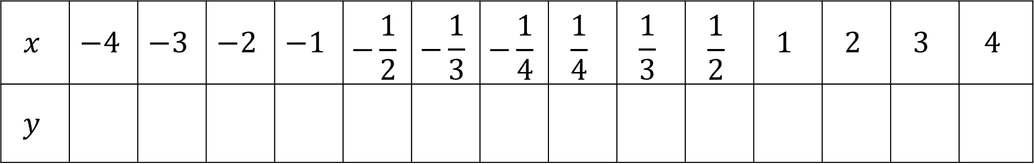





Concept Development
The graph of a relationship involving the reciprocal of $x$ is called a hyperbola
Consider the rule $y=\frac{1}{x}$
$$x$$ | $$−4$$ | $$−3$$ | $$−2$$ | $$−1$$ | $$−\frac{1}{2}$$ | $$−\frac{1}{3}$$ | $$−\frac{1}{4}$$ | $$\frac{1}{4}$$ | $$\frac{1}{3}$$ | $$\frac{1}{2}$$ | $$1$$ | $$2$$ | $$3$$ | $$4$$
$$y$$
$$−\frac{1}{4}$$
$$−\frac{1}{3}$$
$$−\frac{1}{2}$$
$$\frac{1}{2}$$
$$\frac{1}{3}$$
$$\frac{1}{4}$$
$$−1$$
$$−2$$
$$−3$$
$$−4$$
$$4$$
$$3$$
$$2$$
$$1$$
What happens when $x=0?$
What happens when $y=0?$
Your graph is undefined at x, y = 0, they become your asymptotes

Slide 3
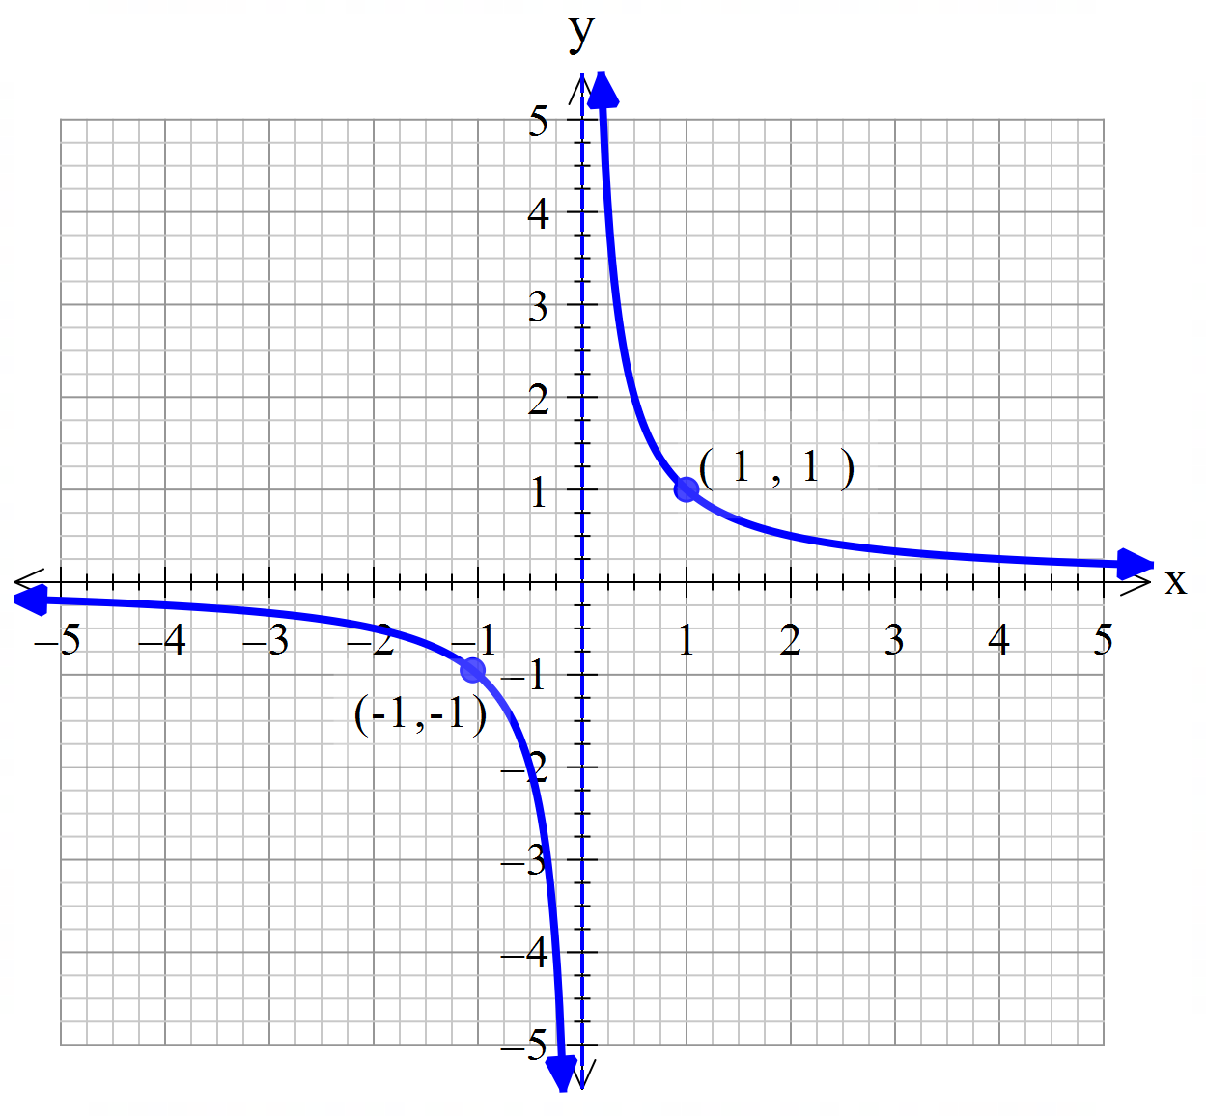
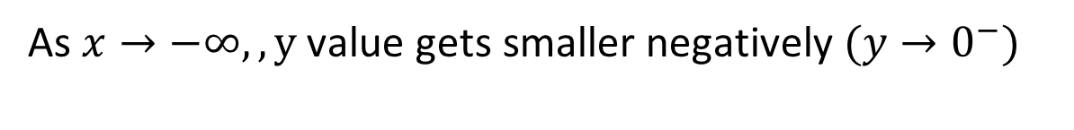


Concept Development
Asymptotes:
A line or boundary that a curve approaches, but will never reach it (will never touch it nor cross the line)
$$x=0$$
Asymptote are always sketched in dotted lines.
Behaviour of the graph
$$y=0$$
As $x→ +∞, y$ value gets smaller positively $(y→0^{+})$
As $x→0^{+}, y$ value gets larger positively $(y→+∞)$
As $x→−∞,, y \text{value} \text{gets} \text{smaller} \text{negatively} (y→0^{−})$
As $x→0^{−},y \text{value} \text{gets} \text{larger} \text{negatively} (y→−∞)$

Slide 4
Concept Development
Key features of a rectangular hyperbola graph:
$$x=0$$
Vertical Asymptotes
Horizontal Asymptotes
2 key coordinates (1, 1,) and (-1, -1)
$$y=0$$
Any $x−$ and $y−$ intercepts

Slide 5

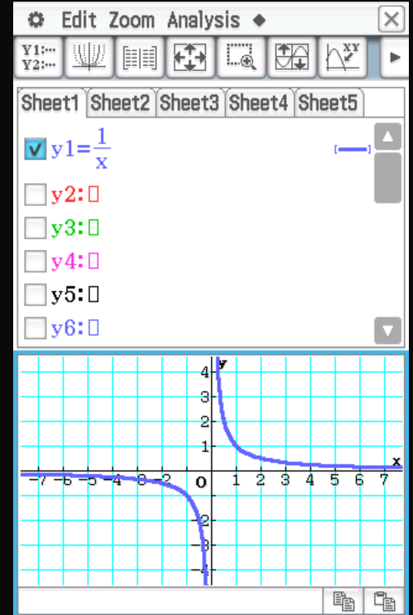
Plotting in ClassPad
Go to
Enter in Equation:$\frac{1}{x}, check it and graph$

Slide 6
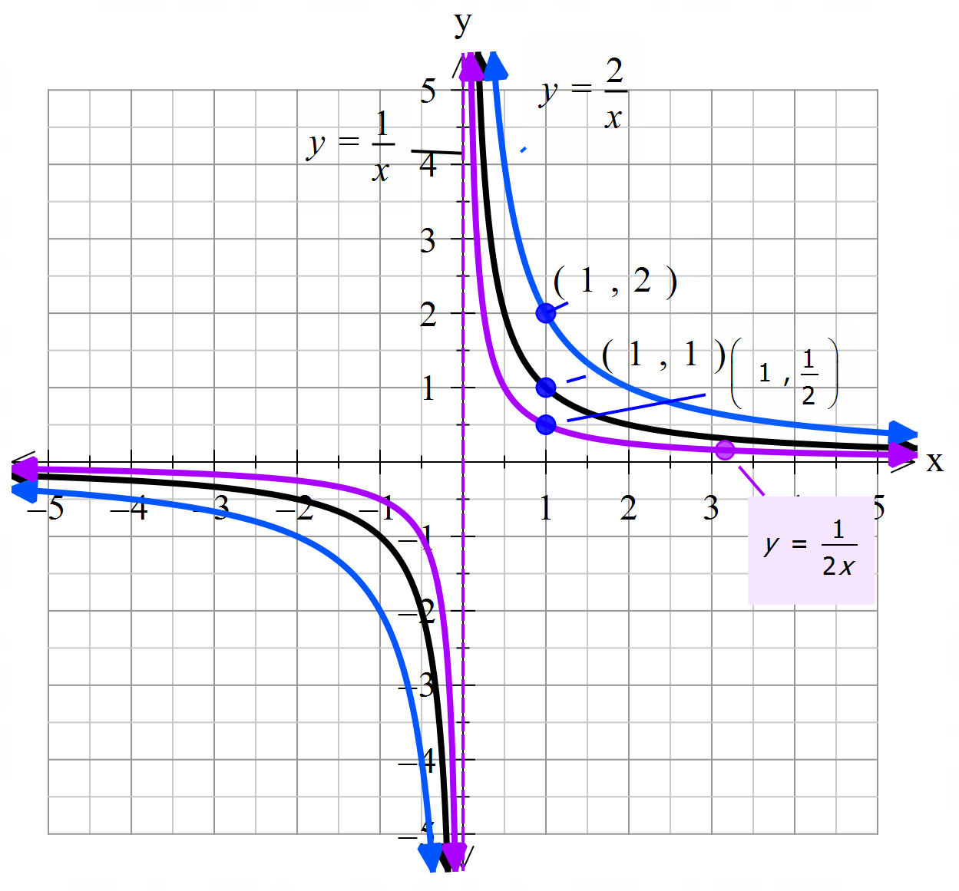

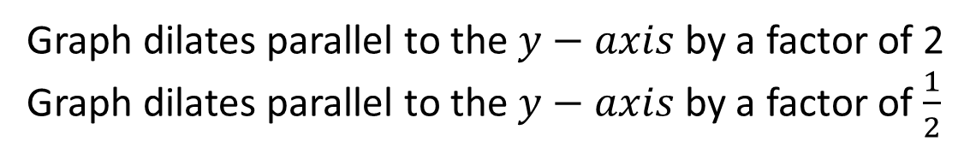

Transformation - Dilation
$y=\frac{1}{x}$ , $y=\frac{2}{x}$, $y=\frac{1}{2x}$
Graph in your ClassPad
Describe the transformation:
$$x=0$$
Graph dilates parallel to the $y−axis$ by a factor of 2
Graph dilates parallel to the $y−axis$ by a factor of $\frac{1}{2}$
Effect on the Asymptotes
Effect on key coordinates (-1, -1), and (1, 1)
Effect on x- and y - intercepts
$$y=0$$
No change to asymptotes
Change to y-coordinate
$$\left(−1,−2\right), \left(1, 2\right) \\ \left(−1,−\frac{1}{2}\right), (1,\frac{1}{2})$$
No intercepts

Slide 7
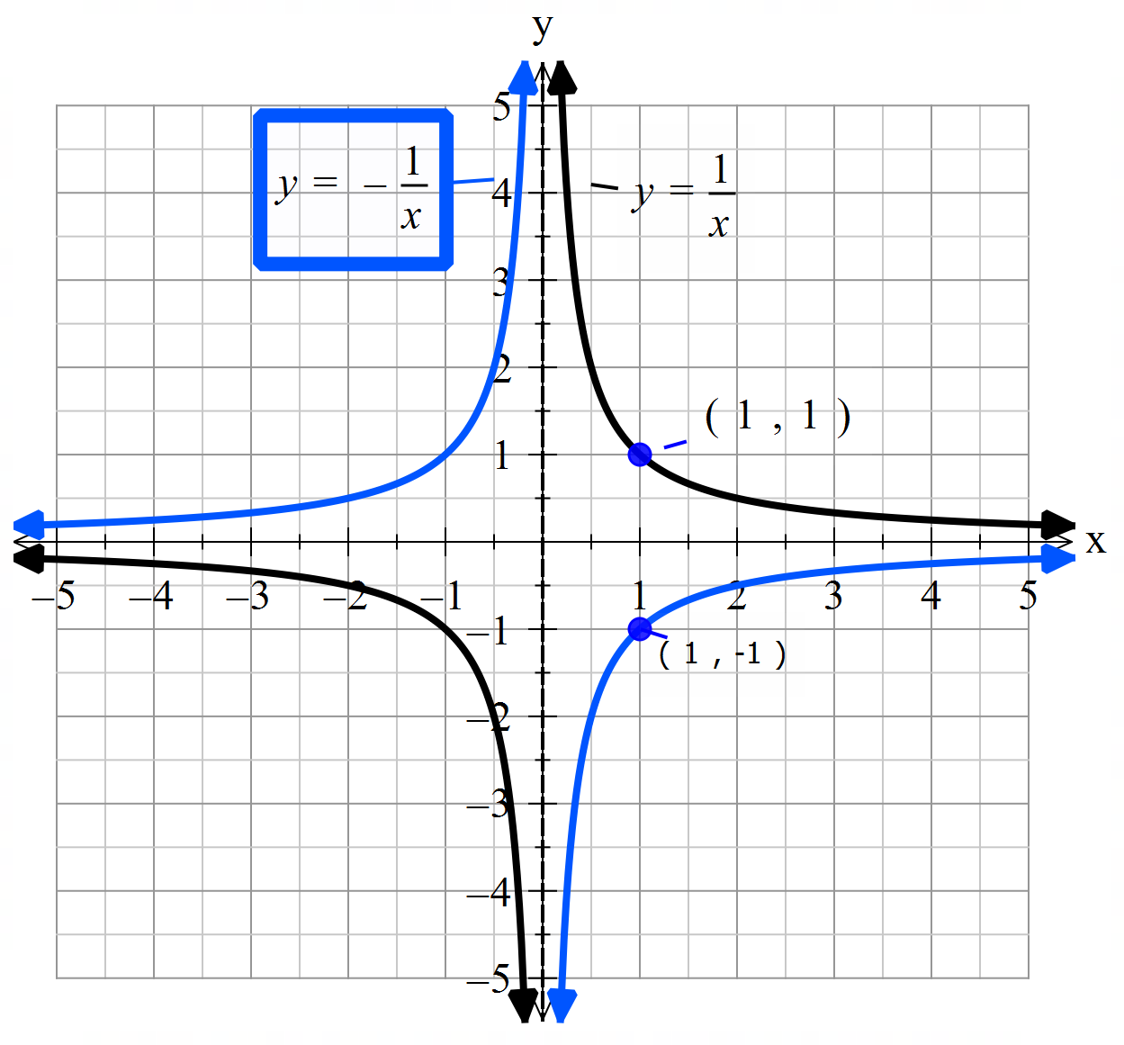

Transformation - Reflection
$y=\frac{1}{x}$ , $y=−\frac{1}{x}$,
Graph in your ClassPad
Compare your graphs and describe the transformation:
$$x=0$$
Graph reflects about the $x−axis$
Effect on the Asymptotes
Effect on key coordinates (-1, -1), and (1, 1)
Effect on x- and y - intercepts
No change to asymptotes
$$y=0$$
Change to y-coordinate
$$\left(−1,1\right), \left(1, −1\right)$$
No intercepts

Slide 8
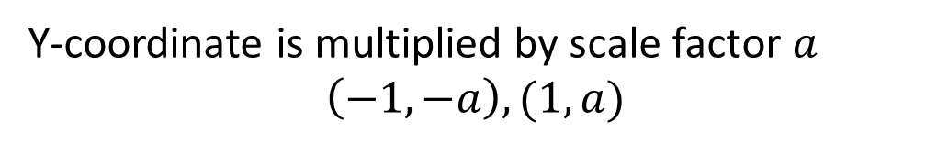

Transformation – Dilation and Reflection
$$y=\frac{1}{x} → y=\frac{a}{x}$$
$$x=0$$
Transformation
Asymptotes
Key coordinates (-1, -1), and (1, 1)
x- and y - intercepts
$a>0$Graph dilates parallel to the $y−axis$ by a factor of $a$
$a<0$Graph reflects about the $x−$ axis
No change to asymptotes
$$y=0$$
Y-coordinate is multiplied by scale factor $a$ $$\left(−1,−a\right), (1,a)$$
No intercepts

Slide 9
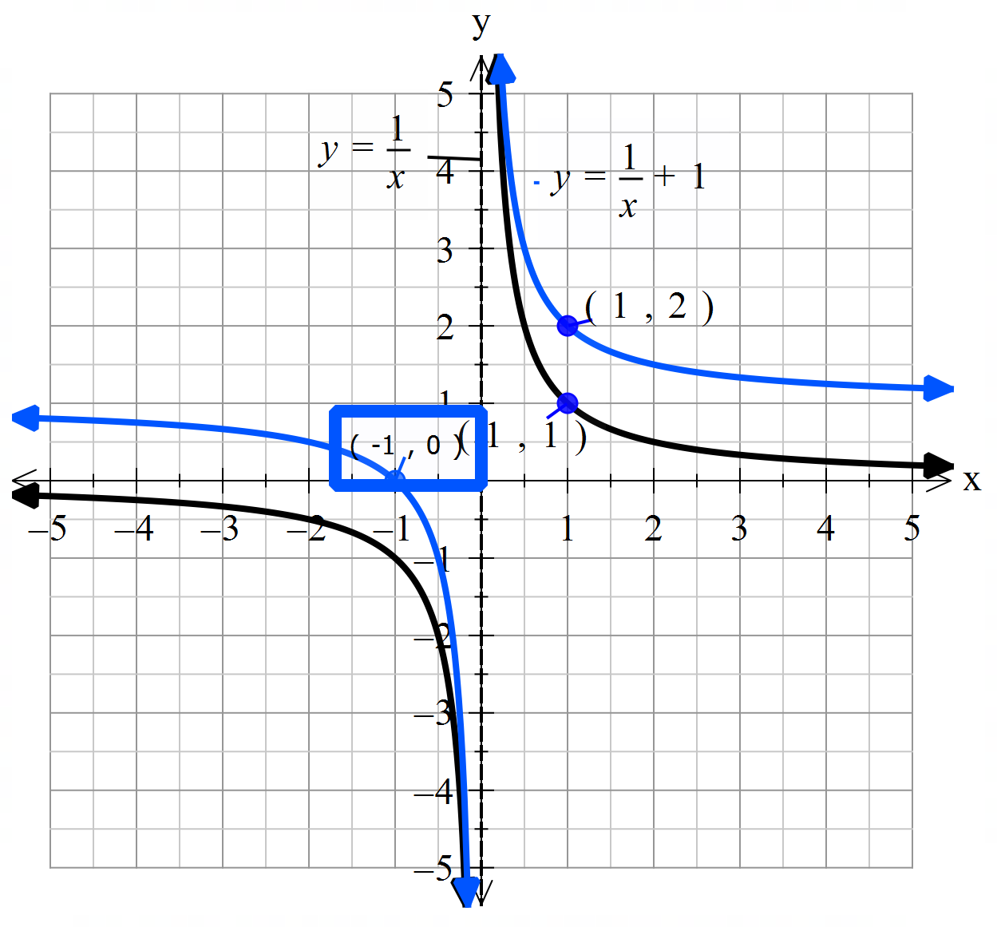




Transformation – Vertical Translation
$y=\frac{1}{x}$ and $y=\frac{1}{x}+1$
Graph in your ClassPad
Compare your graphs and describe the transformation:
$$x=0$$
Graph translates vertically up by 1 unit.
Effect on the Asymptotes
Effect on key coordinates (-1, -1), and (1, 1)
Effect on x- and y - intercepts
$$y=1$$
Horizontal Asymptote translates 1 unit up
$$y=0$$
Change to y-coordinate
$$\left(−1,0\right), \left(1, 2\right)$$
X-intercept $\left(−1,0\right)$

Slide 10

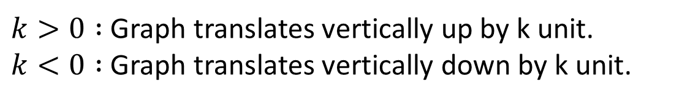
Transformation – Vertical Translation
$$y=\frac{1}{x} → y=\frac{1}{x}+k$$
Transformation
Asymptotes
Key coordinates (-1, -1), and (1, 1)
x- and y - intercepts
$$x=0$$
$k>0 :$Graph translates vertically up by k unit. $k<0 :$Graph translates vertically down by k unit.
$$y=1$$
Horizontal Asymptote translates up/down by k units
$$y=0$$
Key coordinates translates up/down by k units
X-intercept exists. Substitute y=0 to determine x-intercept

Slide 11
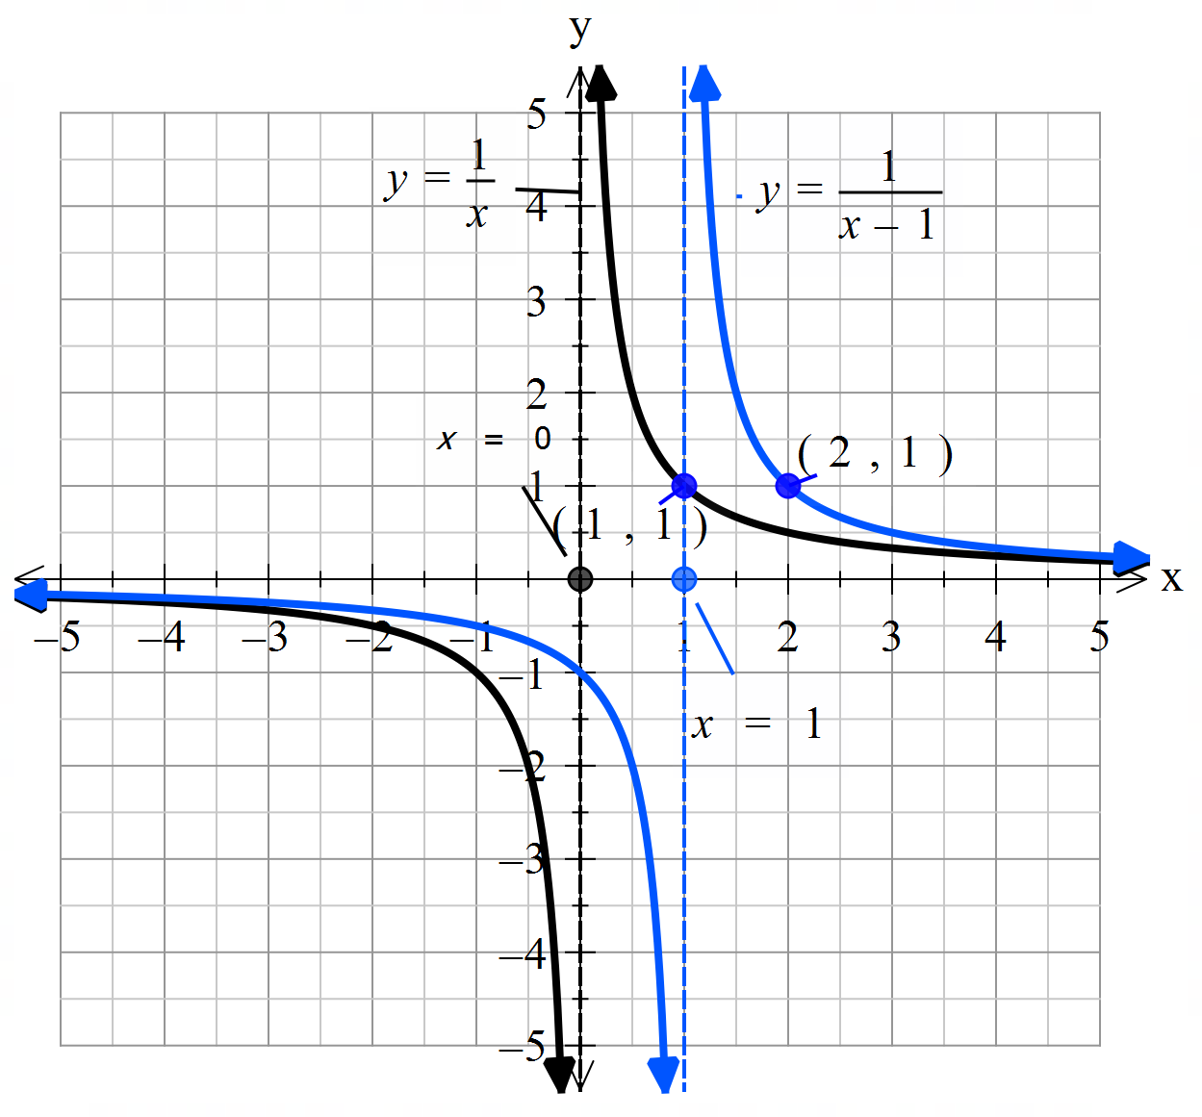

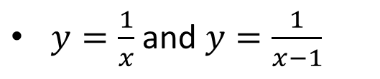

Transformation – Horizontal Translation
$y=\frac{1}{x}$ and $y=\frac{1}{x−1}$
Graph in your ClassPad
Compare your graphs and describe the transformation:
$$x=0$$
Graph translates horizontally to the right by 1 unit.
Effect on the Asymptotes
Effect on key coordinates (-1, -1), and (1, 1)
Effect on x- and y - intercepts
Vertical Asymptote translates 1 unit to the right
$$y=0$$
(0,-1)
Change to x-coordinate
$$\left(0,−1\right), \left(2, 1\right)$$
y-intercept $\left(0,−1\right)$

Slide 12
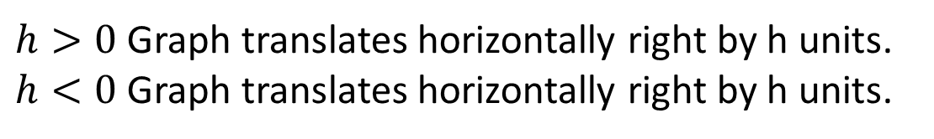
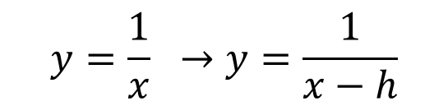
Transformation – Horizontal Translation
$$y=\frac{1}{x} →y=\frac{1}{x−h}$$
$$x=0$$
Transformation
Asymptotes
Key coordinates (-1, -1), and (1, 1)
x- and y - intercepts
$h>0$Graph translates horizontally right by h units. $h<0$Graph translates horizontally right by h units.
$$y=0$$
Vertical Asymptote translates left/right by h units
(0,-1)
Key coordinates translates left/right by h units
y-intercept exists. Substitute x=0 to determine y-intercept

Slide 13

Cambridge Ex 4A Q1&2
Sketch the graph by determine the key features $y=\frac{−3}{x}$
Transformation
Asymptotes
Key coordinates (-1, -1), and (1, 1)
x- and y - intercepts
Graph dilates parallel to the y-axis by 3 units and reflects about the x-axis
No change to asymptotes
$$\left(−1,3\right), \left(1, −3\right)$$
No intercepts

Slide 14
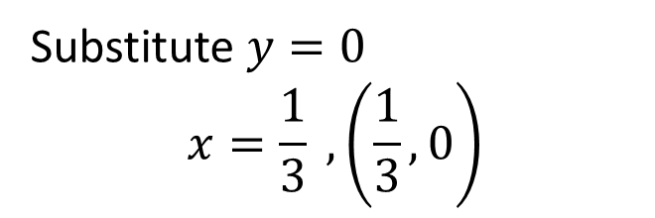

Cambridge Ex 4A Q1&2
Sketch the graph by determine the key features $y=\frac{1}{x}−3$
Transformation
Asymptotes
Key coordinates (-1, -1), and (1, 1)
x- and y - intercepts
Graph translates vertically down by 3 units
Horizontal asymptotes translates down by 3 units
$$\left(−1,−4\right), \left(1, −2\right)$$
Substitute $y=0$ $$x=\frac{1}{3} , \left(\frac{1}{3},0\right)$$

Slide 15
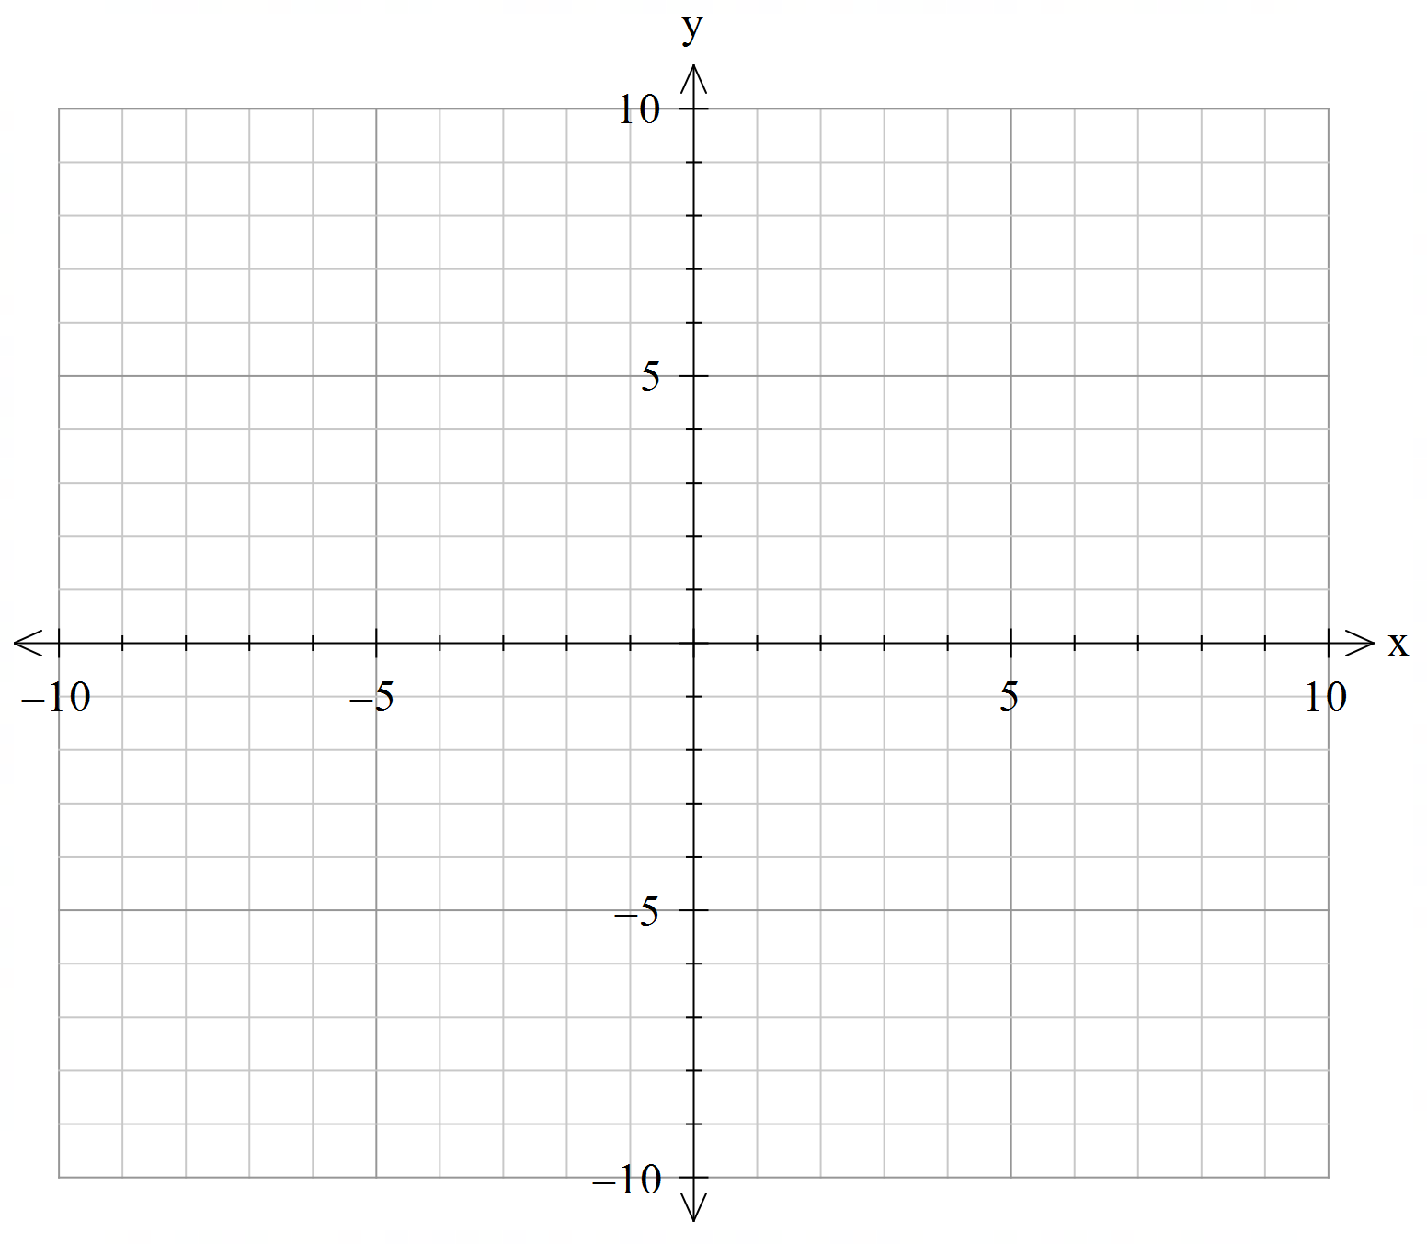


Cambridge Ex 4A Q1&2
Sketch the graph by determine the key features $y=\frac{1}{x+2}$
Transformation
Asymptotes
Key coordinates (-1, -1), and (1, 1)
x- and y - intercepts
Graph translates horizontally left by 2 units
Vertical asymptotes translates left by 2 units
$$\left(−3,−1\right), \left(−1, 1\right)$$
y-intercept $\left(0,\frac{1}{2}\right)$

Slide 16
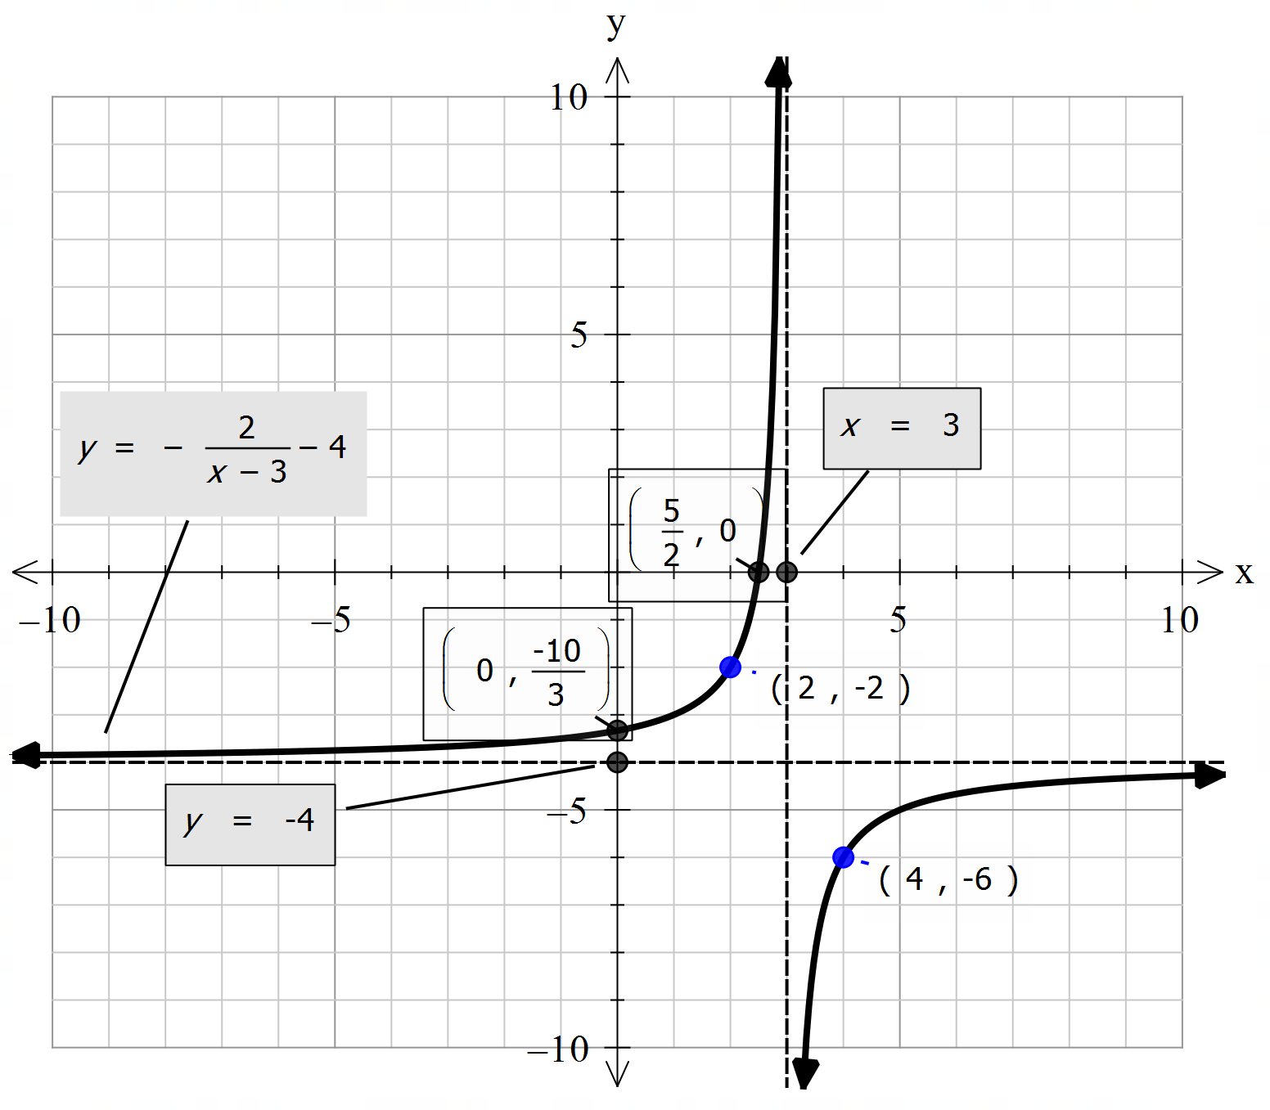
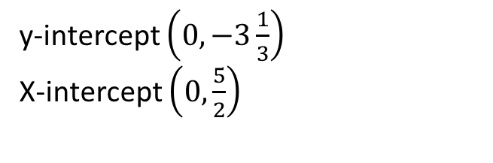
Cambridge Ex 4A Q1&2
Sketch the graph by determine the key features $y=\frac{−2}{x−3}−4$
Transformation
Asymptotes
Key coordinates (-1, -1), and (1, 1)
x- and y - intercepts
Graph dilates parallel to the y-axis by 2 units and reflects about the x-axis
Graph translates horizontally to the right by 3 units Graph translates down by 4 units
Vertical asymptotes translates horizontally to the right by 3 units
Horizontal asymptotes translates down by 4 units
$$\left(−1,−1\right)→\left(−1,2\right)→\left(2,2\right)→(2,−2)$$
$$\left(1,1\right)→\left(1,−2\right)→\left(4,−2\right)→(4,−6)$$
y-intercept $\left(0,−3\frac{1}{3}\right)$
X-intercept $\left(0,\frac{5}{2}\right)$

Slide 17
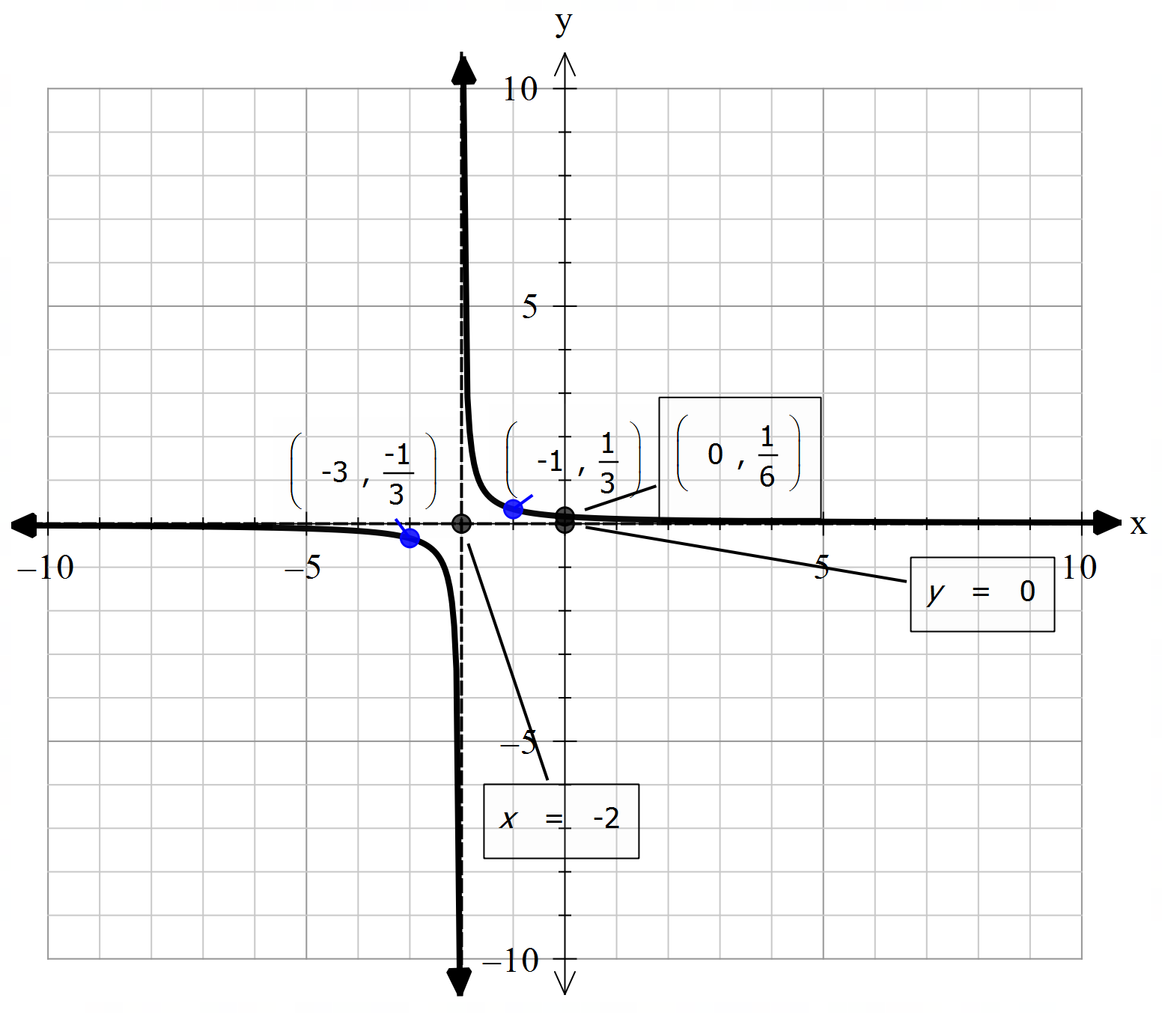


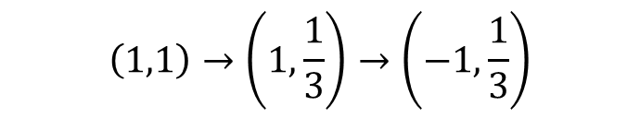

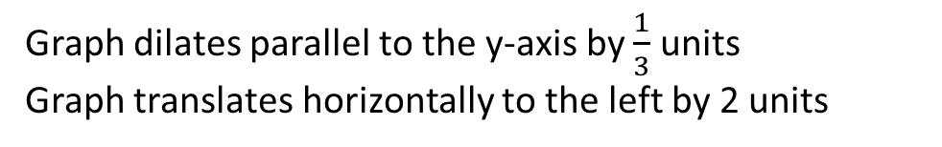
Cambridge Ex 4A Q1&2
Sketch the graph by determine the key features $y=\frac{1}{3x+6}$
Rewrite $y=\frac{1}{3\left(x+2\right)}$
Transformation
Asymptotes
Key coordinates (-1, -1), and (1, 1)
x- and y - intercepts
Graph dilates parallel to the y-axis by $\frac{1}{3}$ units
Graph translates horizontally to the left by 2 units
Vertical asymptotes translates horizontally to the left by 2 units
$$\left(−1,−1\right)→\left(−1,−\frac{1}{3}\right)→\left(−3,−\frac{1}{3}\right)$$
$$\left(1,1\right)→\left(1,\frac{1}{3}\right)→\left(−1,\frac{1}{3}\right)$$
y-intercept $\left(0,\frac{1}{6}\right)$

Slide 18
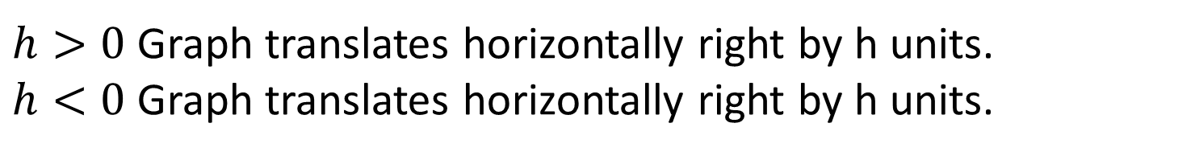
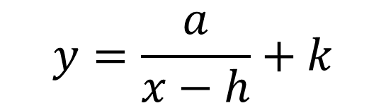
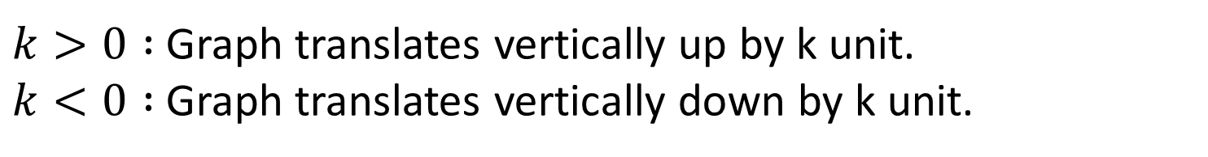
General Form of rectangular hyperbola
$$y=\frac{a}{x−h}+k$$
Vertical Asymptote: $x=h$
Horizontal Asymptote: $y=k$
$a>0$: Dilation parallel to the y-axis by a factor of $a$
$a<0$: Reflection about the x-axis
$h>0$Graph translates horizontally right by h units. $h<0$Graph translates horizontally right by h units.
$k>0 :$Graph translates vertically up by k unit. $k<0 :$Graph translates vertically down by k unit.

Slide 19
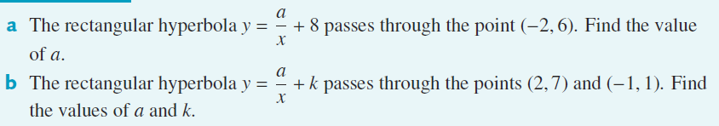

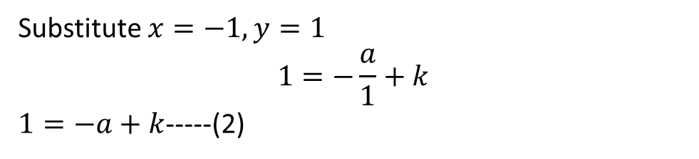
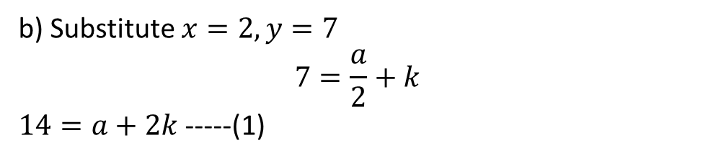

Cambridge Ex 4E Q1
a) Substitute $x=−2, y=6$ $$6=\frac{a}{−2}+8 \\ −2=\frac{a}{−2} \\ a=4 \\ y=\frac{4}{x}+8$$
b) Substitute $x=2, y=7$ $$7=\frac{a}{2}+k$$ $14=a+2k$ -----(1)
(1)+(2), $$15=3k \\ k=5 \\ 1=−a+5 \\ a=4 \\ y=\frac{4}{x}+5$$
Substitute $x=−1, y=1$ $$1=−\frac{a}{1}+k$$ $1=−a+k$-----(2)

Slide 20
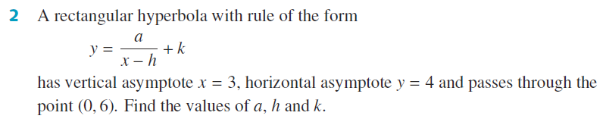



Cambridge Ex 4E Q2
Vertical asymptote, $x−h=0$ $$x=h \\ h=3$$
Horizontal asymptote, $k=4$
$y=\frac{a}{x−3}+4$
Substitute $x=0,y=6$ $$6=\frac{a}{−3}+4 \\ 2=\frac{a}{−3} \\ a=−6 \\ y=−\frac{6}{x−3}+4$$

Slide 21
Independent Practice
Cambridge Ex 4A

